Slide 1
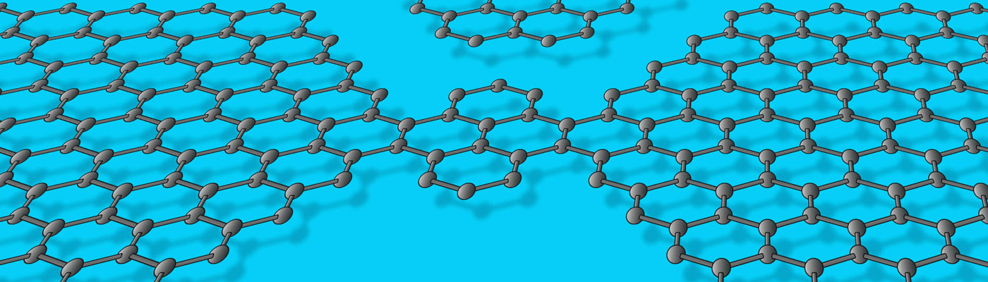
Analysis of the Supply and Demand Pattern of the Chinese Rare Earth Market in 2024 and Prospects for 2025
May 2025 Ningbo●Zhejiang

Slide 2
Main Contents
1、Brief introduction
2、Current situation of Rare Earth Supply and Demand
3、Trends in Rare Earth Demand
4、Rare Earth Supply Capacity
5、Main Insights

Slide 3
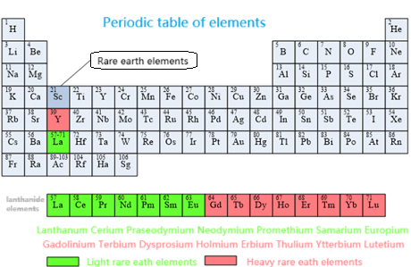
Rare earths are a collective term for a group of metallic elements, including 15 lanthanide elements, as well as scandium (Sc) and yttrium (Y), totaling 17 elements.
Promethium (Pm) does not exist in nature, and scandium (Sc) is rarely coexistent. Usually, rare earths refer to 15 elements.
Rare earth elements are divided into two or three groups. The dichotomy method classifies lanthanum - europium as light rare earths, and gadolinium - lutetium and yttrium as heavy rare earths. This article adopts the dichotomy method.
The content of rare earth elements in the earth's crust is not very low, with an abundance higher than that of mercury and silver. The abundances of different rare earth elements in the earth's crust vary greatly.

Slide 4
The abundance of cerium is even higher than that of common metals such as copper, lead, and nickel, but it rarely accumulates into deposits that can be economically mined.
The abundances of light rare earth elements are higher than those of heavy rare earths, and the abundances of elements with even atomic numbers are higher than those of adjacent elements with even atomic numbers.
Lanthanum, cerium, praseodymium, and neodymium account for 80 - 99% in the vast majority of rare earth deposits.
Unless otherwise specified, the consumption and production data in this article are REO data.

Slide 5
The rare earth consumption data in China from 2000 to 2012 are from the annual reviews of Chinese rare earths over the years.
The rare earth consumption data from 2013 to 2024 are estimated based on the production data of rare earth intermediate products (such as phosphors, permanent magnets, etc.) and the ratio parameters of the production and consumption of rare earth intermediate products from 2008 to 2012.
The application proportions of rare earth elements in various sectors are from the USGS.
The data of the United States are from the USGS; The data of Japan are from JOGMEC; Some data are from the Australian IMCOA consulting company.
Reserves and resource reserves are two different professional terms, and the value of resource reserves is much higher than that of reserves.

Slide 6
Main Application Fields of Rare Earths
Application Field or Material | Use | Main Rare Earth Elements Involved
Agriculture | As trace elements in multi - element compound fertilizers to promote yield increase. | Lanthanum, Cerium
Light and Textile Industry | Tanning fur, dyeing, etc.
Metallurgy | Remove impurities in steel, aluminum, magnesium, copper and improve performance. | Lanthanum, Cerium, Praseodymium, Neodymium
Petrochemical | As a catalyst to increase the productivity of gasoline. | Lanthanum, Cerium, Praseodymium
Glass/Ceramic | Glass coloring, decolorization, preparation of special glass, as well as ceramic pigments and manufacture of special ceramics. | Lanthanum, Cerium, Praseodymium, Neodymium, Yttrium, etc.
Magnetic Materials | Neodymium - iron - boron permanent magnets are the strongest permanent magnetic materials today, used in TV sets, medical equipment MRI, maglev trains, hybrid vehicles, military and other fields. | Praseodymium, Neodymium, Samarium, Terbium, Dysprosium
Hydrogen Storage Materials | Nickel - metal hydride batteries, as "green energy", are widely used in laptops, mobile phones, video cameras, etc., and are also being developed as a power source for electric vehicles. | Lanthanum, Cerium, Praseodymium, Neodymium, Samarium
Laser Materials | Currently, about 90% of laser materials involve rare earths. Among the 45 commercially available laser materials in the world, more than 30 are rare - earth - based laser materials. | Lanthanum, Cerium, Ytterbium
Rare Earth Polishing Powder | For optoelectronic precision devices (semiconductor chips), color TV display picture tubes, liquid crystal displays, optical lenses, etc. | Cerium, Lanthanum, Praseodymium, Mixed Metals
Luminescent Materials | Indispensable light emitters for color TVs and various displays, and also essential materials for manufacturing modern green lighting sources such as trichromatic energy - saving lamps and metal halide lamps | Europium, Yttrium, Terbium, Dysprosium, Cerium, Praseodymium, Gadolinium

Slide 7
Main Application Fields of Rare Earths
 | Lanthanum | Cerium | Praseodymium | Neodymium | Samarium | Europium | Gadolinium | Terbium | Dysprosium | Yttrium | Others
Permanent Magnets | - | - | √ | √ | √ | - | √ | √ | √ | - | -
Catalysts (Automotive) | √ | √ | √ | √ | - | - | - | - | - | - | -
Catalysts (Petrochemical) | √ | √ | - | - | - | - | - | - | - | - | -
Battery Alloys | √ | √ | √ | √ | √ | - | - | - | - | - | -
Alloys (Non - Battery) | √ | √ | √ | √ | - | - | - | - | - | - | -
Phosphors | √ | √ | - | - | - | √ | √ | √ | - | √ | -
Polishing Powder | √ | √ | √ | - | - | - | - | - | - | √ | √
Glass Additives | √ | √ | √ | √ | - | - | - | - | - | √ | √
Ceramics | √ | √ | √ | √ | - | - | - | - | - | √ | -
Others | √ | √ | √ | √ | √ | - | √ | - | - | √ | √

Slide 8
Type | Description | Unit | Low - value Consumption | High - value Consumption
Wind Turbines | Average magnet consumption per megawatt | kg | 200 | 600
 | Proportion of neodymium in magnet weight | % | 31 | 31
 | Proportion of dysprosium in magnet weight | % | 2 | 4
New Energy Vehicles | Average magnet consumption per vehicle | kg | 1 | 2
 | Proportion of neodymium in magnet weight | % | 31 | 31
 | Proportion of dysprosium in magnet weight | % | 4.5 | 6
 | Lanthanum consumption in nickel - metal hydride batteries for hybrid vehicles | kg | 0.49 | 0.73
 | Cerium consumption in nickel - metal hydride batteries for hybrid vehicles | kg | 0.69 | 1.03
 | Neodymium consumption in nickel - metal hydride batteries for hybrid vehicles | kg | 0.2 | 0.31

Slide 9
Type | Description | Unit | Low - value Consumption | High - value Consumption
Energy - saving Lamps | Phosphor content per energy - saving lamp | g | 1.1 | 1.5
 | Proportion of rare earths in trichromatic phosphors by weight | % | 60 | 60
 | Proportion of lanthanum in rare earths of phosphors | % | 8.5 | 8.5
 | Proportion of cerium in rare earths of phosphors | % | 20 | 20
 | Proportion of europium in rare earths of phosphors | % | 4.5 | 4.5
 | Proportion of terbium in rare earths of phosphors | % | 5 | 5
 | Proportion of yttrium in rare earths of phosphors | % | 62 | 62
Polishing Powder | Proportion of rare earths in polishing powder by weight | % | 66 | 95
 | Proportion of cerium in rare earths of polishing powder | % | 50 | 99
 | Proportion of lanthanum in rare earths of polishing powder | % | 0 | 35
 | Proportion of neodymium in rare earths of polishing powder | % | 0 | 15
 | Proportion of praseodymium in rare earths of polishing powder | % | 0 | 5

Slide 10
Main Contents
1、Brief introduction
2、Current situation of Rare Earth Supply and Demand
3、Trends in Rare Earth Demand
4、Rare Earth Supply Capacity
5、Main Insights

Slide 11
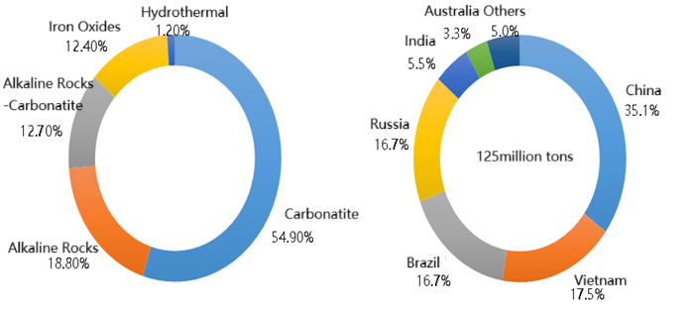
Rare earth deposits can generally be classified into two categories: endogenic and exogenic (epigenetic). Endogenic rare earth deposits include carbonatite type, alkaline rock type, alkaline rock carbonatite type, iron oxide type, and hydrothermal vein type. Exogenic rare earth deposits include weathered crust ion adsorption type, sedimentary rock type, associated type in sedimentary minerals (coal, bauxite, and sedimentary phosphate), placer type, and modern ocean bottom soft mud type.

Slide 12
Carbonatite type accounts for 54.9% of global rare earth mines, alkaline rock type accounts for 18.8%, alkaline rock carbonatite type accounts for 12.7%, iron oxide type and hydrothermal type account for 12.4% and 1.2% respectively, and placer type and other types (including weathered crust ion adsorption type) have not been included in the statistics yet.
In 2024, China's rare earth reserves were 44 million tons, accounting for 35.1% of the global total. Vietnam had 22 million tons, accounting for 17.5%. Both Brazil and Russia had 21 million tons, each accounting for 16.7%. India had 6.9 million tons, accounting for 5.5%. Australia had 4.2 million tons, accounting for 3.3%. Other countries and regions accounted for 5%.

Slide 13
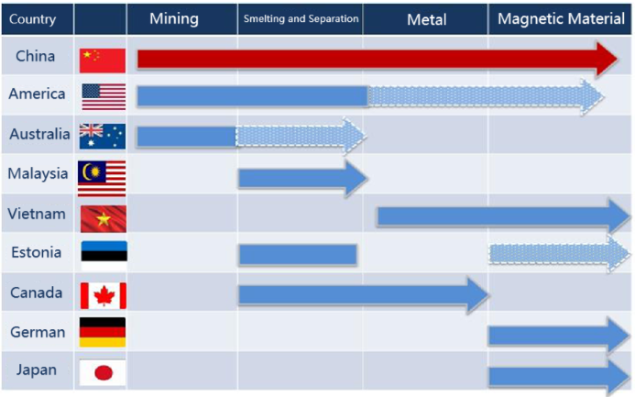
The global rare earth industry has basically formed two supply chains: one is the rare earth supply chain centered around China, and the other is the rare earth supply chain centered around the United States, Australia, and Japan.

Slide 14
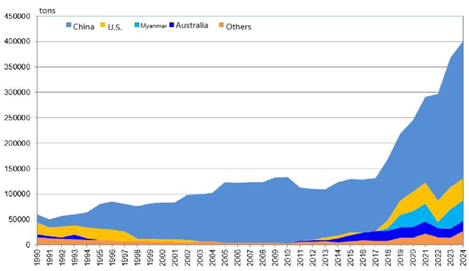
Western countries such as the United States, in order to get rid of their dependence on China's rare earth supply, have formed a mining, dressing, and separation supply chain with an annual output of nearly 120,000t of rare earth ore and about 50,000t of smelting and separation products through upstream and downstream integration.
Combining the original research and development, manufacturing, and application capabilities of rare earth functional materials in the United States and Japan, an independent rare earth supply chain and industrial chain have been initially established.

Slide 15
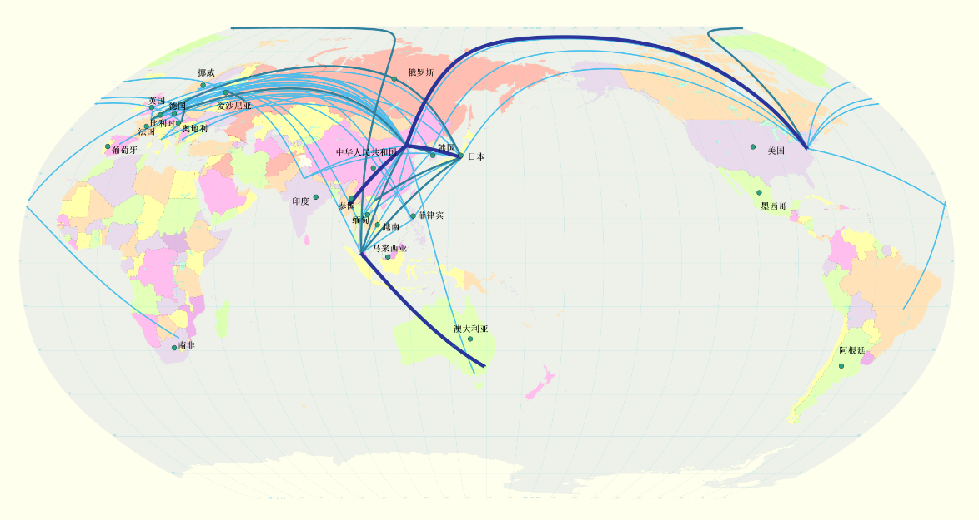
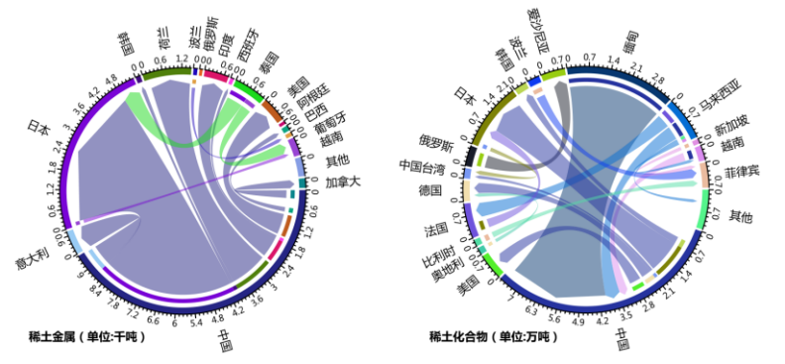
The main global rare earth trade products include rare earth concentrates, rare earth metals, rare earth oxides and compounds, rare earth permanent - magnetic materials, etc.

Slide 16
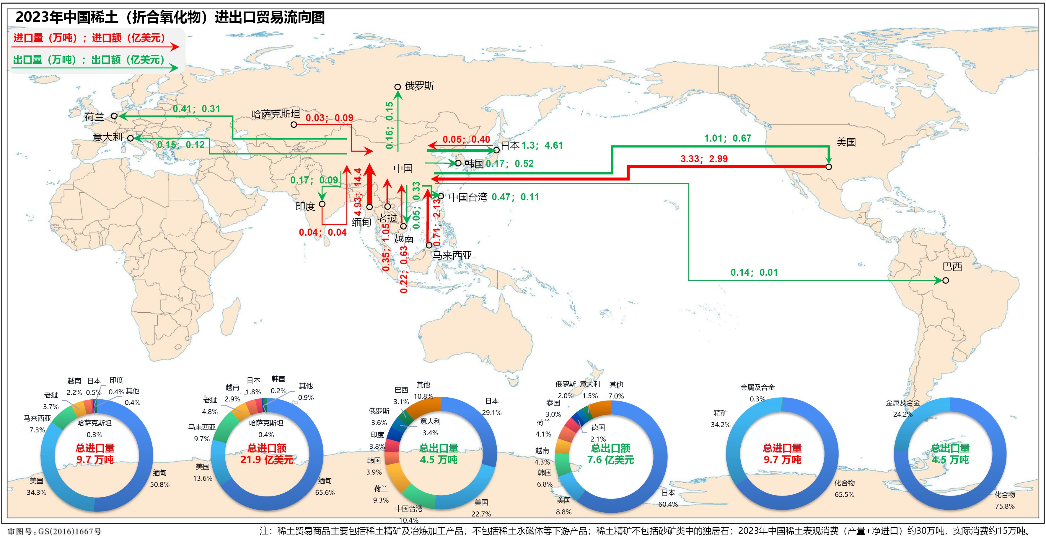
China's Rare Earth (in Terms of Oxides)
Import and Export Trade Flow

Slide 17
Main Contents
1、Brief introduction
2、Current situation of Rare Earth Supply and Demand
3、Trends in Rare Earth Demand
4、Rare Earth Supply Capacity
5、Main Insights

Slide 18
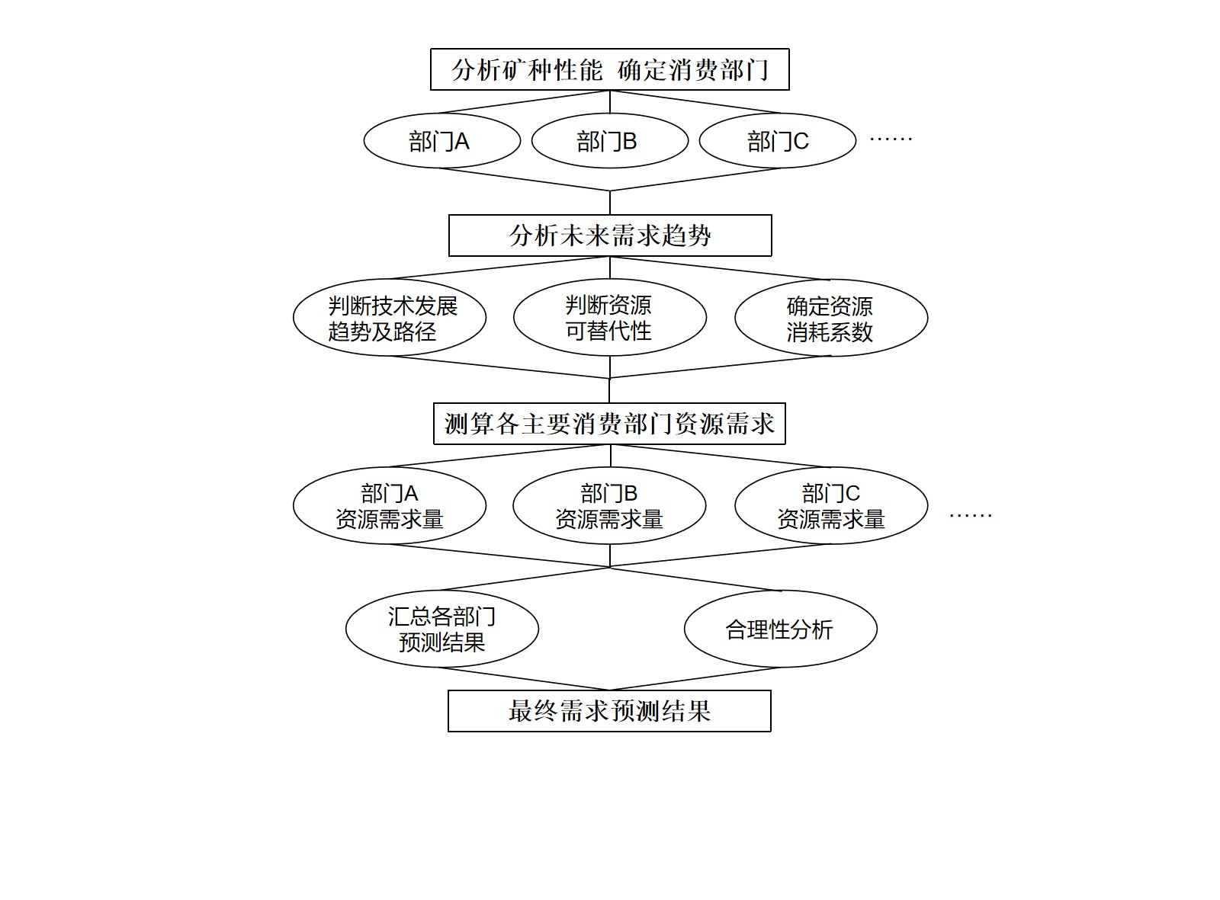
Forecast of rare earth demand
Forecast method of department demand
Adopt the "sector demand + trend extrapolation" method.
Starting from the analysis of the rare earth consumption structure, use the main direct products of rare earths as "consumption sectors".
Predict the future demands of each "consumption sector", and then obtain the total demand by summation.
Predict the demands of each "consumption sector" by analyzing the future development trends of the main application industries of the main products.
Use the historical consumption trends to correct and limit.

Slide 19
China has long ranked first in global rare earth consumption this century.
In 2024, China's consumption accounted for 79% of the global total.
Japan reached its consumption peak in 2007 and has been steadily declining since then.
The United States has maintained a consumption level of around 10,000t in recent years.

Slide 20
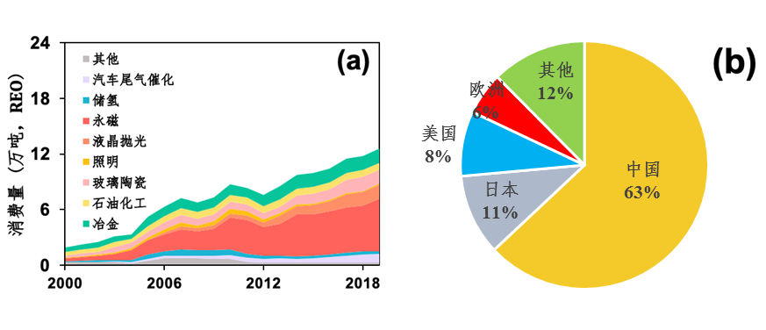
 | Magnetic Materials | Catalytic Materials |  | Polishing Materials | Luminescent Materials |  |  | Hydrogen Storage Alloys
 |  | Cracking Catalysis | Tail Gas Purification Catalysis |  | Trichr-omatic | LED | Long Persistent Lumines-ence
Unit | 10,000t | 10,000t | 10,000L | 10,000t | t | t | t | t
2020 | 18.81 | 20.0 | 1450 | 3.10 | 1113 | 439 | 242.8 | 10092
2021 | 21.94 | 23.0 | 1440 | 4.40 | 831 | 698 | 262.5 | 10778
2022 | 25.20 | 22.0 | 2140 | 3.73 | 666 | 554 | 240.5 | 9243
2023 | 27.20 | 22.7 | 2085 | 3.62 | 447 | 766 | 265.5 | 9281
2024 | 30.00 | 23.0 | 2100 | 3.70 | 400 | 800 | 280.0 | 8500
2025e | 33.00 | 23.5 | 2150 | 4.00 | 380 | 850 | 300.0 | 8700
2026e | 35.50 | 24.0 | 2200 | 4.30 | 350 | 900 | 320.0 | 9000
Chinese rare earth consumption amount in different sectors
In China, the mechanical metallurgy and petrochemical fields were the main rare earth consumption sectors in the early stage.
This century has witnessed the great development of permanent magnetic materials, liquid crystal polishing materials, luminescent materials, catalytic materials, and hydrogen - storage materials.
The proportion of permanent magnetic materials in the total rare earth consumption increased rapidly from 17% in 2000 to 43% in 2019.

Slide 21
 | Magnetic Materials | Catalytic Materials |  | Polishing Materials | Luminescent Materials |  |  | Hydrogen Storage Alloys
 |  | Cracking Catalysis | Tail Gas Purification Catalysis |  | Trichr-omatic | LED | Long Persistent Lumines-ence
Unit | 10,000t | 10,000t | 10,000L | 10,000t | t | t | t | t
2020 | 18.81 | 20.0 | 1450 | 3.10 | 1113 | 439 | 242.8 | 10092
2021 | 21.94 | 23.0 | 1440 | 4.40 | 831 | 698 | 262.5 | 10778
2022 | 25.20 | 22.0 | 2140 | 3.73 | 666 | 554 | 240.5 | 9243
2023 | 27.20 | 22.7 | 2085 | 3.62 | 447 | 766 | 265.5 | 9281
2024 | 30.00 | 23.0 | 2100 | 3.70 | 400 | 800 | 280.0 | 8500
2025e | 33.00 | 23.5 | 2150 | 4.00 | 380 | 850 | 300.0 | 8700
2026e | 35.50 | 24.0 | 2200 | 4.30 | 350 | 900 | 320.0 | 9000
Chinese rare earth consumption amount in different sectors
Permanent magnetic materials are mainly used in low carbon energy technologies such as wind turbines and electric vehicles.
The lighting industry has shrunk, and the consumption of europium and yttrium has decreased since 2010.
From 2000 to 2024, the cumulative rare earth consumption in China was approximately 2.35 million tons.

Slide 22
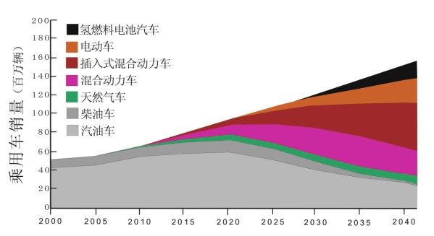
Cumulative installed capacity of wind power
under the blueprint scenario
Changing trends of the sales of various types of vehicles under the blueprint scenario.
Driven by the carbon neutrality goal, in the future, low carbon energy technologies such as energy saving home appliances, electric vehicles, and wind turbines would become the main driving forces for the rapid growth of these rare earth elements.
The rapid popularization and application of flat panel display devices have also greatly driven the rapid growth of the demand for rare earth elements such as lanthanum and cerium used in glass ceramics and liquid crystal polishing.

Slide 23
Forecast of China's New Energy Vehicle Production
“New Energy Vehicle Industry Development Plan (2021 - 2035)” released by the State Council.
“Energy saving and New Energy Vehicle Technology Roadmap 2.0” compiled by experts organized by the China Society of Automotive Engineers under the guidance of the Ministry of Industry and Information Technology.
In 2030 and 2035, the production volume of new energy vehicles in China would reach 15 million units and 24 million units respectively.

Slide 24
Rare earth permanent magnetic materials are mainly used in electronic information communication, wind power, transportation, and consumer electronics products. The future development trends of these products determine the development of rare earth permanent magnetic materials, including wind turbines, new energy vehicles, electric bicycles, mobile phones, tablet computers, electromechanical products, and micro - special motors.
Polishing powder is mainly used in the mobile phone and micro - crystal glass fields, but the premise is that the price remains at a reasonable level.
Hydrogen storage materials, also known as hydrogen storing materials or hydrogen storage alloys, are an important field of rare earth application. The great development of hydrogen energy technology would lead to a rapid increase in demand.
Rare earth catalytic materials are used in the exhaust gas purification of vehicles such as cars and motorcycles. The great development of new energy vehicles would gradually limit the use of rare earth based catalysts.

Slide 25
Metallurgical machinery is an important field of rare earth consumption. There is still room for growth in the demand for some high quality and special purpose steel products, and the rare earth consumption in the metallurgical field would not change significantly.
Petroleum refining and chemical industry is an important field of rare earth application, and catalytic technology plays an extremely important role. The global demand for oil would still be in a growth stage, and the demand for petroleum cracking catalysts would still increase.
The glass and ceramic industry is a traditional application field of rare earths. The demand for special glass would still grow, and functional ceramics would further increase with the development of high - tech industries.
The agriculture, light industry, and textile industry is a traditional application field of rare earths. The rare earth consumption in this field has been decreasing year by year and is estimated to be close to the bottom. The future demand would not increase.

Slide 26
Forecast of Global Rare Earth demand
It is predicted that the global rare earth demand would reach 360,000t, 470,000t, and 550,000t in 2025, 2030, and 2035 respectively.
In 2035, the rare earth demand in the United States would reach 35,000t.
In 2035, China would account for 72% of the global demand.
The rare earth demand in China would reach 260,000t, 310,000t, and 380,000t in 2025, 2030, and 2035 respectively.
Permanent - magnetic materials would still be the largest rare earth consumer product, accounting for 56% in 2035.

Slide 27
Main Contents
1、Brief introduction
2、Current situation of Rare Earth Supply and Demand
3、Trends in Rare Earth Demand
4、Rare Earth Supply Capacity
5、Main Insights

Slide 28
Changes of Global Rare Earth Supply
The global rare earth industry has formed a diversified supply pattern of "one large and many small".
In 2024, China's rare earth production was approximately 270,000t, accounting for about 69% of the global total.
The global share of rare earth production in the United States, Australia, Brazil, India, and other countries has increased to 31%.
The annual output of light rare earth elements such as lanthanum, cerium, praseodymium, and neodymium in China is about ten times that of heavy rare earths.

Slide 29
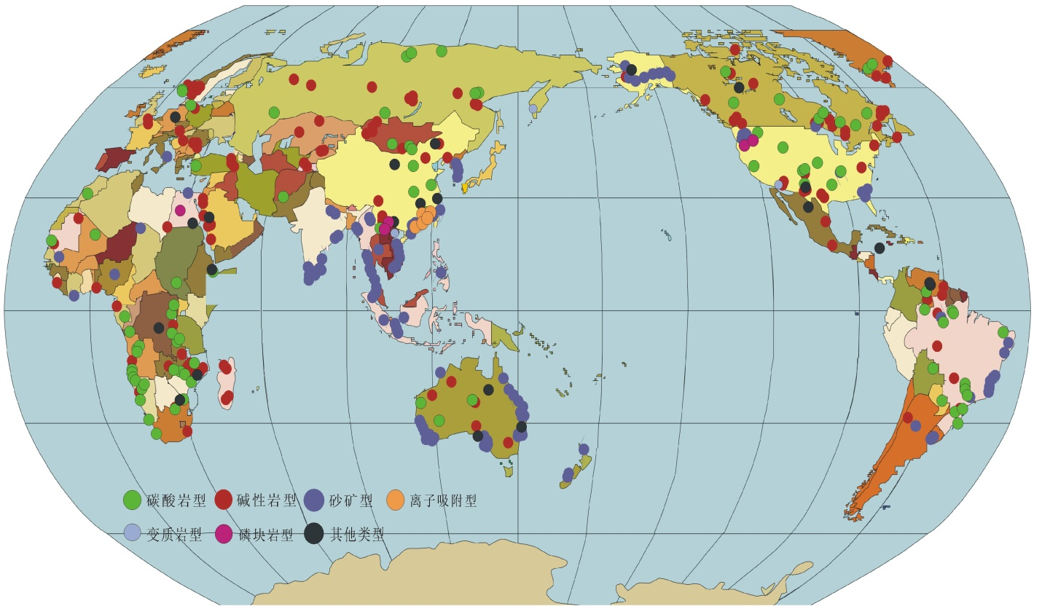
The Distribution of Global Rare Earth Deposits
Global rare earths are mainly distributed in countries such as China, Brazil, Russia, and Vietnam.
In 2024, the global rare earth reserves were nearly 140 million tons.
China accounted for 57% of the global total, Brazil 16%, Russia 9%, and Vietnam 8%.
Most of the rare earths in Southeast Asia are of the ion adsorption type. The distribution of heavy rare earths is similar to or higher than that in Jiangxi, China.
In Southeast Asia, only the potential resource volume of ion adsorption rare earths in Myanmar can exceed 15 million tons, showing amazing potential.

Slide 30
 | 2022 | 2023 | 2024 | 2025e | 2026e
China | 210000 | 255000 | 268000 | 300840 | 340000
America | 42000 | 43000 | 45000 | 45000 | 45000
Australia | 18000 | 18000 | 21000 | 21000 | 22000
Brazil | 80 | 80 | 500 | 600 | 600
India | 2900 | 2900 | 2900 | 2900 | 3000
Malaysia | 80 | 80 | 200 | 500 | 1000
Russia | 2600 | 2600 | 2600 | 2600 | 2600
Thailand | 7100 | 7100 | 7300 | 7500 | 7500
Vietnam | 1200 | 600 | 5000 | 5500 | 6000
Madagascar | 960 | 960 | 960 | 1000 | 1000
Burundi | 0 | 0 | 0 | 0 | 0
Myanmar | 12000 | 38000 | 42500 | 45000 | 45000
Others | 0 | 0 | 0 | 80 | 80
Total | 297000 | 368500 | 396000 | 432000 | 474000
Global Rare Earth Supply Capacity
The Mount Pass Mine in the United States and the Mount Weld Mine in Australia are operating at full capacity. At the same time, both mines are undergoing expansion.
The development of mines such as the Yangibana Mine of Hastings Corporation and the Nolans Mine of Arafura Resources in Australia is also underway.

Slide 31
 | 2022 | 2023 | 2024 | 2025e | 2026e
China | 210000 | 255000 | 268000 | 300840 | 340000
America | 42000 | 43000 | 45000 | 45000 | 45000
Australia | 18000 | 18000 | 21000 | 21000 | 22000
Brazil | 80 | 80 | 500 | 600 | 600
India | 2900 | 2900 | 2900 | 2900 | 3000
Malaysia | 80 | 80 | 200 | 500 | 1000
Russia | 2600 | 2600 | 2600 | 2600 | 2600
Thailand | 7100 | 7100 | 7300 | 7500 | 7500
Vietnam | 1200 | 600 | 5000 | 5500 | 6000
Madagascar | 960 | 960 | 960 | 1000 | 1000
Burundi | 0 | 0 | 0 | 0 | 0
Myanmar | 12000 | 38000 | 42500 | 45000 | 45000
Others | 0 | 0 | 0 | 80 | 80
Total | 297000 | 368500 | 396000 | 432000 | 474000
Global Rare Earth Supply Capacity
Southeast Asian countries like Myanmar, Laos, Malaysia, and Vietnam have abundant rare earth ore reserves and are gradually starting to mine rare earth ores.
In the next few years, driven by the growing demand, the global supply of rare earth ores would continue to increase.
It is expected that the global rare earth ore production would reach 432,000t in 2025, with China's production accounting for about 70%.

Slide 32
Chinese Rare Earth Supply Capacity
Based on the current situation analysis, China's monopoly position in the international light rare earth supply market has weakened to some extent, but its dominant position would not be lost.
This is mainly for the following reasons: first, China has huge resource advantages; second, it has a strong cost - advantage; third, it has technological advantages in mining, smelting, and separation.
In the case of heavy rare earths, China's supply position has declined, while the supply status of Southeast Asian regions, especially Myanmar, has risen.
The specific supply volume is mainly affected by the control indicators of rare earth mining and smelting.

Slide 33
 | 2022 | 2023 | 2024 | 2025e | 2026e
China | 288149 | 369391 | 380568 | 396100 | 409435
Malaysia | 16551 | 13960 | 11273 | 15500 | 20000
America |  | 1300 | 7831 | 10000 | 15000
Others | 2150 | 2150 | 2500 | 3000 | 3000
Total | 306851 | 386801 | 402172 | 424600 | 447435
Global Rare Earth Smelting and Separation Capacity
It is expected that China's smelting and separation targets would continue to grow in line with the growth rate of demand.
In early 2024, the Malaysian smelting and separation plant of Lynas Corporation completed its capacity expansion.
Lynas' local plant in Australia has also been built and put into production, and two rare earth smelting and separation plants it is building in Texas, the United States, are planned to start production.
The light rare earth smelting and separation capacity of MP Materials in the United States was completed and put into production in the third quarter of 2023, with an annual capacity of 25,000t.

Slide 34
 | 2022 | 2023 | 2024 | 2025e | 2026e
China | 288149 | 369391 | 380568 | 396100 | 409435
Malaysia | 16551 | 13960 | 11273 | 15500 | 20000
America |  | 1300 | 7831 | 10000 | 15000
Others | 2150 | 2150 | 2500 | 3000 | 3000
Total | 306851 | 386801 | 402172 | 424600 | 447435
Global Rare Earth Smelting and Separation Capacity
The Silmet plant of NEO Materials in Estonia remains in stable operation and is considering expansion.
The solvent extraction process of the US Energy Fuels is under improvement and debugging.
Countries such as India and Vietnam are also actively seeking to expand their rare earth production.
The production of rare earth smelting and separation products would show an upward trend in the next two years. In 2025, the global production of rare earth oxides is expected to be approximately 425,000t.

Slide 35
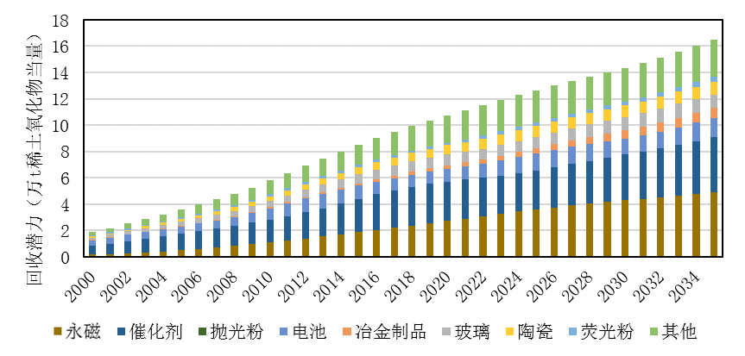
Global Rare Earth Secondary Resource Recycling Potential from 2025 to 2035
From 2025 to 2035, the annual global rare earth recycling potential would continue to increase.
The cumulative recycling potential is 2 million tons, mainly distributed in permanent magnets and catalysts.

Slide 36
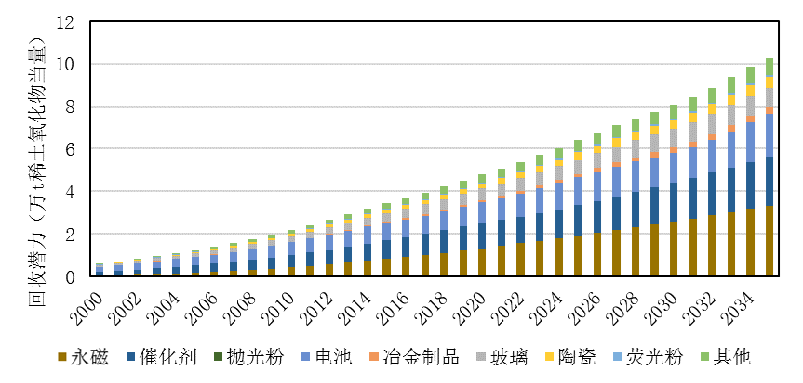
Recycling Potential of Chinese Rare Earth Secondary Resources from 2025 to 2035
From 2025 to 2035, the cumulative recycling potential of Chinese rare earth secondary resources is 1 million tons.
By 2035, the recycling potential would exceed 100,000t.
The recycling potential is mainly distributed in permanent magnets, catalysts, and batteries. Cerium, neodymium, and lanthanum have the greatest recycling potential.
At the current stage, the actual rare earth recycling volume of major economies is negligible compared with the recycling potential.

Slide 37
Recycling Potential of Chinese Rare Earth Secondary Resources from 2025 to 2035
Some factories in Japan have started research on rare earth recycling. Germany has the ability to recycle about 500t of rare earths annually.
France can produce 200t of rare earth metals from waste fluorescent lamps, permanent magnets, and batteries every year.
There are enterprises in Denmark that have recycled neodymium iron boron.
Chinese enterprises such as Umicore have also carried out work related to rare earth recycling.
Recycling is mainly restricted by factors such as technology, economy, policy, and market.

Slide 38
Main Contents
1、Brief introduction
2、Current situation of Rare Earth Supply and Demand
3、Trends in Rare Earth Demand
4、Rare Earth Supply Capacity
5、Main Insights

Slide 39
The future availability of rare earths in China is sufficient, but there are significant differences among elements.
The distribution ratios of neodymium, dysprosium, praseodymium, and terbium are relatively low, and their consumption ratios are higher than their corresponding production ratios.
The growth rates of lanthanum and cerium consumption are relatively stable. However, their distribution contents are high, and the production ratios are much higher than the consumption ratios.
The mismatch between production and consumption ratios would lead to an oversupply of some elements.
The shortages of dysprosium, yttrium, praseodymium, and neodymium resources would gradually become apparent.

Slide 40
Thank you for your
comments and suggestions

